Slide 1
Year 6 transition meeting
For Parents/Carers

Slide 2
Our hopes for this meeting
What does being ‘secondary ready’ mean?
What can you as parents do to support your children being ‘secondary ready’?
What are school doing to support children being ‘secondary ready’?
Q & A – both general and specific for your child’s secondary school.

Slide 3
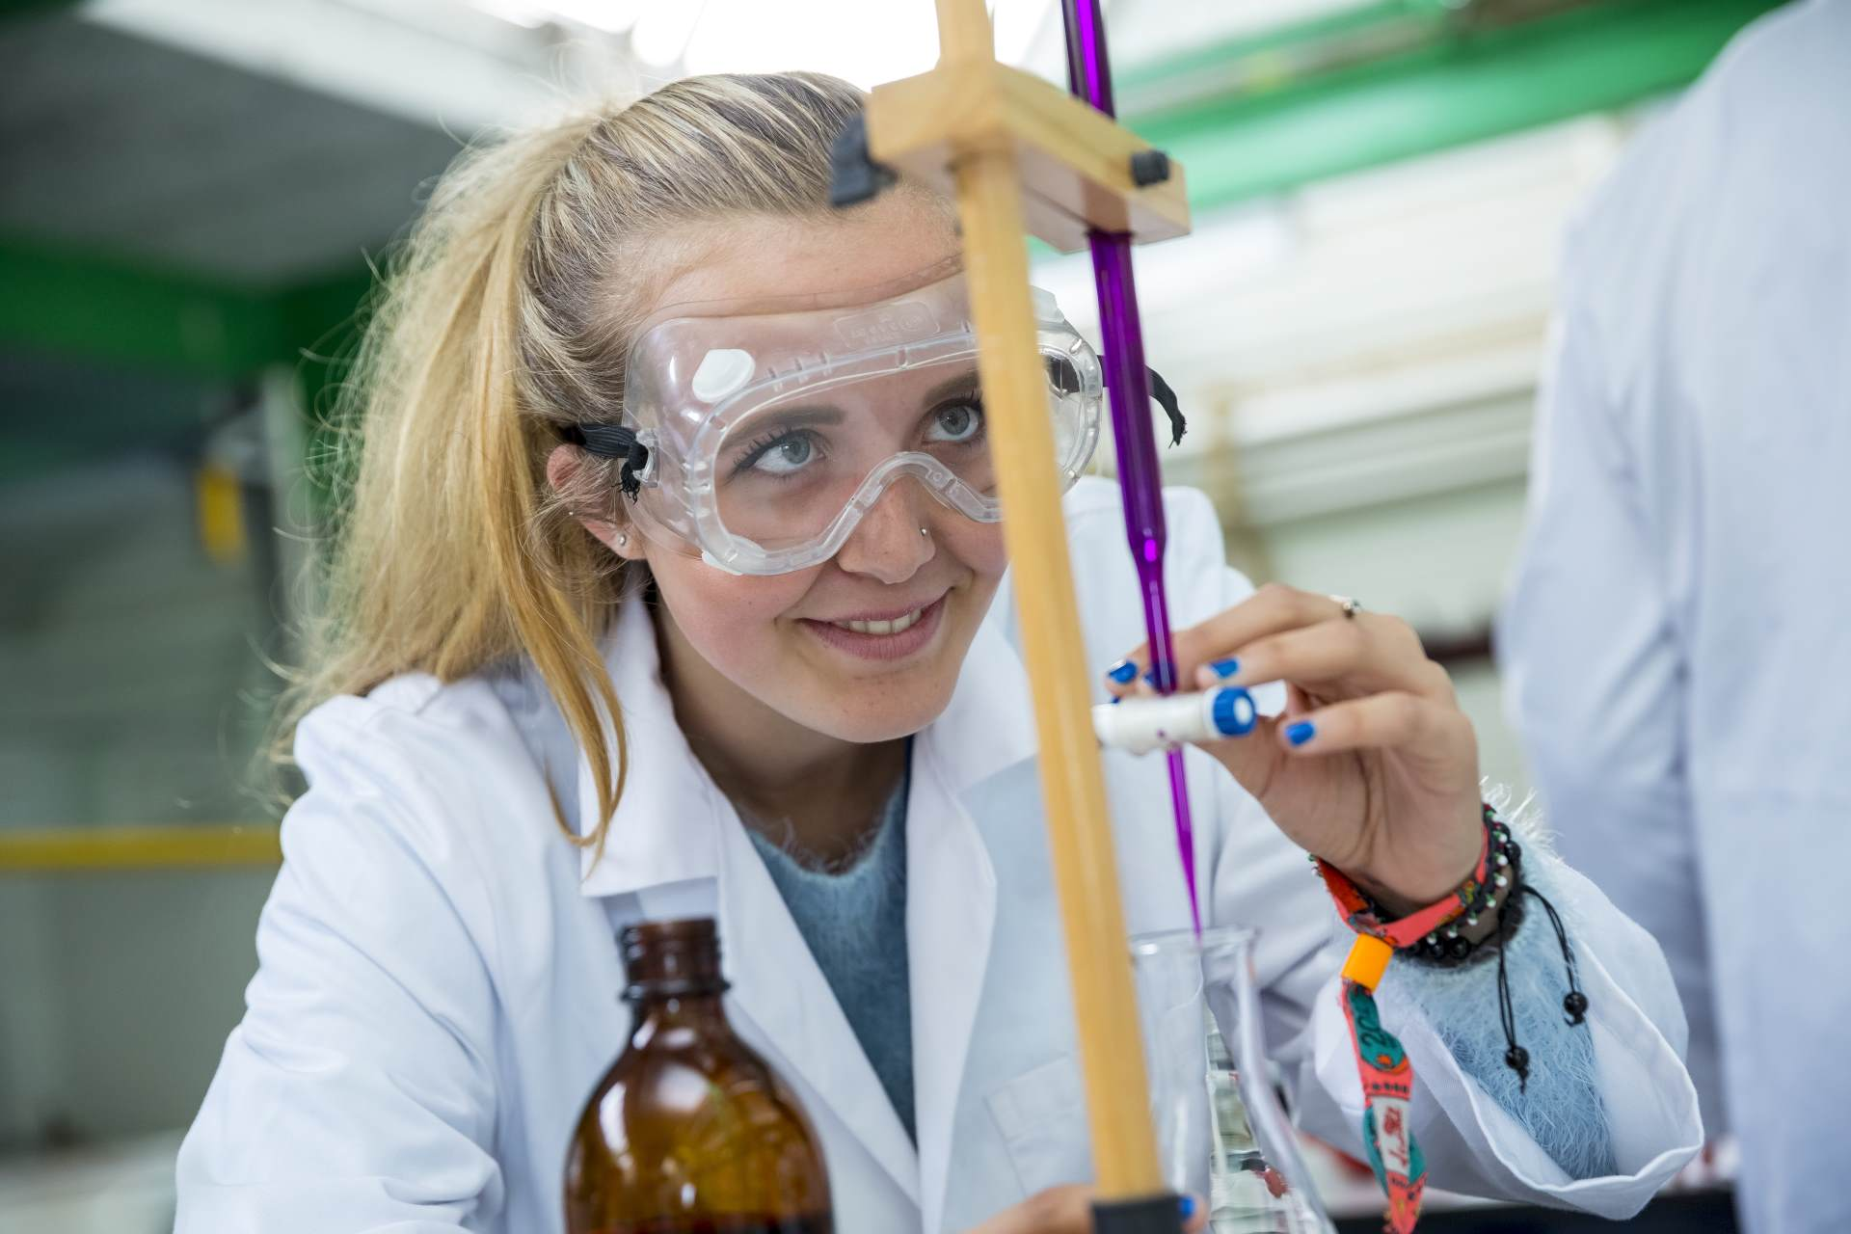
Moving on UP
Starting secondary school can be daunting. There are countless new demands on young people as they transition from being the ‘top dogs’ in primary school to the ‘littlest fish’ in the secondary setting; most new year 7 students will be navigating an unfamiliar building , taking greater responsibility for managing their time and perhaps even studying new subjects.
Favourite things about secondary school

Slide 4
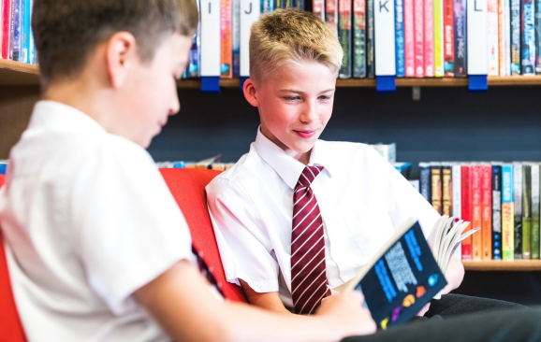
What does being ‘secondary ready’ look like?
Being responsible and able to look after important items e.g. house key, bus pass, planner
Being able to read their timetable and packing their bag accordingly each day
Being punctual for school, lessons, the bus etc.
Being able to manage their time to complete homework
Being tech savvy and safe
This is can all be learnt and practised – do not panic!

Slide 5

What can you do to help?
Help your child plan their route to the bus stop and back, timing it, then practise it regularly to build confidence.
Problem solve with them – what do they do if: the bus doesn’t turn up; the bus is late; they have no bus pass; they forget their food card or cooking equipment etc.
Pack their bag with them until they feel confident.
Give guidance/prompts about time management when doing homework – be warned though!
Help them to know who is there to help in school – their tutor, the pastoral team, their year head, friends, older siblings etc.

Slide 6
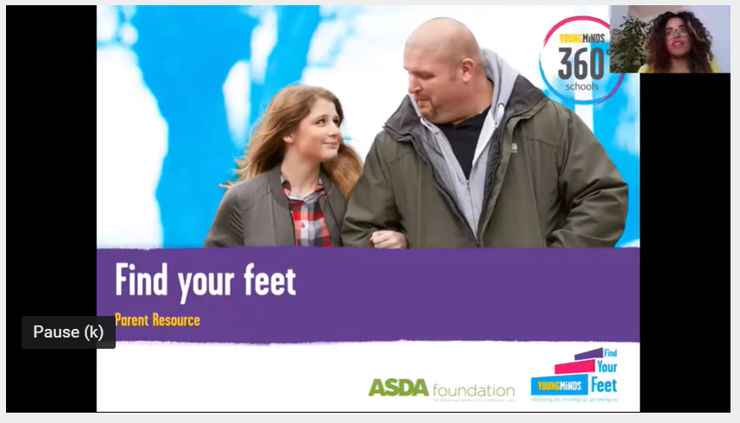
Be prepared for change
Transitioning from primary to secondary school is particularly significant for children and their families. Learning about change and how to cope with it will help them with this transition and prepare them for many other changes and challenges they will face in life.
Young Minds - support for children and parents – videos for children and parents about change and transition, advice, support.
Happy Maps - supporting children going to secondary school – advice about parenting teenagers, links to further support –websites, professional bodies, books, further information and support around topics such as anxiety, sleep, anger, low mood.

Slide 7
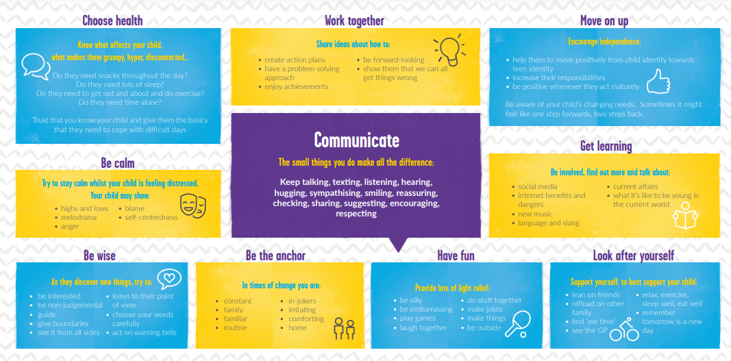

Slide 8

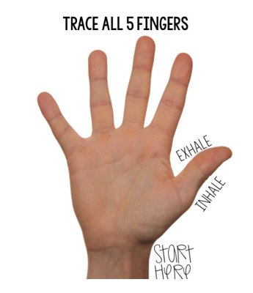
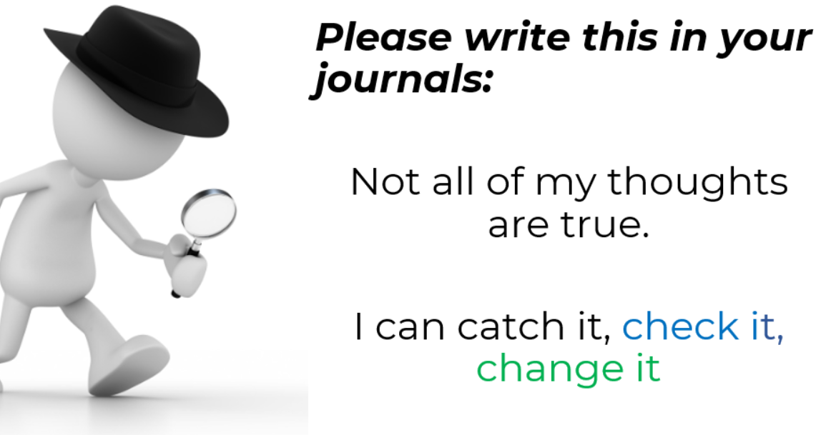
What are we doing in school?
Secondary schools are visiting pupils in school this term and liaising with staff regarding each child.
Detailed information, where necessary, will be shared with schools to support a smooth transition – academic and pastoral
Year 6 transition project – involving Kate Jackson from Wellbeing Therapy Solutions, Amber Mason – Engagement Activator and Scott Moore from CEL Sports.

Slide 9
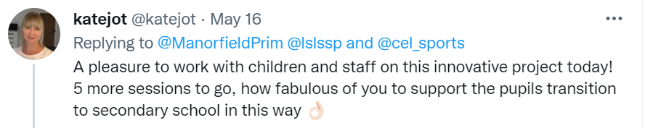

Year 6 transition project
Kate (OT)
Amber
Scott
- Focusing on emotions, helping the children to identify them within themselves, how they may feel or look and strategies that can support children to overcome or manage them.
- Teaching children how journaling can support children in processing information, identifying and talking through in a private space concerns, worries but also importantly, celebrating successes and things they are proud of.
- Teaching skills such as teamwork, resilience and perseverance through sport and physical activity.

Slide 10
Q & A session
All local schools have pages on their websites proving key information:
Https://www.Lutterworthcollege.Com/KS3/induction/
Https://www.Hinckleyacademy.Co.Uk/page/?Title=transition+2021&pid=48
Https://cdn.Realsmart.Co.Uk/c5f22c7112225911383ee95c107f8710/uploads/2021/06/22114040/2021-year-6-transition-booklet.Pdf
Https://www.Saint-martins.Net/year-6-transition.Html
Https://thomasestley.Org.Uk/year-6-pupils
Https://www.Brockington.Leics.Sch.Uk/parents/year-6-transition-2/
What your children are asking:
How many lessons do we have in a day?
Do you get a timetable to tell you what lesson you have next?
Is the food good?
What if I am bullied? What do I do?
Is it a good school?
What lessons will I have?
What time does the bus leave?
What if I miss the bus?
Will we be told off for being late on our first day?
What will happen if you’re late but it’s not your fault?
How will I find my way round?
How do you read a map?
What will happen if I miss the bus?
Notes:
We will speak to the children too about these questions – these will be addressed in the transition project but also as they occur in everyday conversation with children.

Slide 11
Q & A session with friends of Manorfield
Miss Smith | Lutterworth College
Mrs. Maton Marshall | Hinckley Academy
Mrs. Bullock | St Martins Catholic Academy
Mrs. Stratford | Redmoor Academy and Brockington College
Mrs. Bailey | Thomas Estley Community College
Mrs. Rogerson | Pastoral support at Manorfield
Miss Weed | Year 6 teacher at Manorfield
Mrs. Thompson | Deputy and SENCo at Manorfield

Slide 12
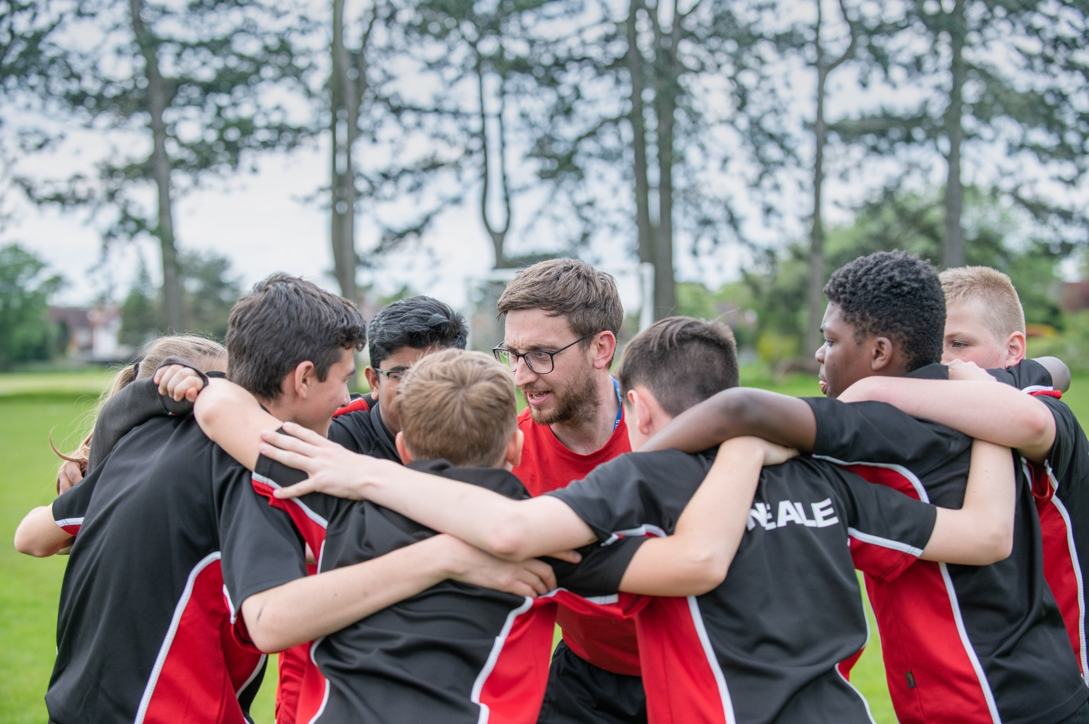
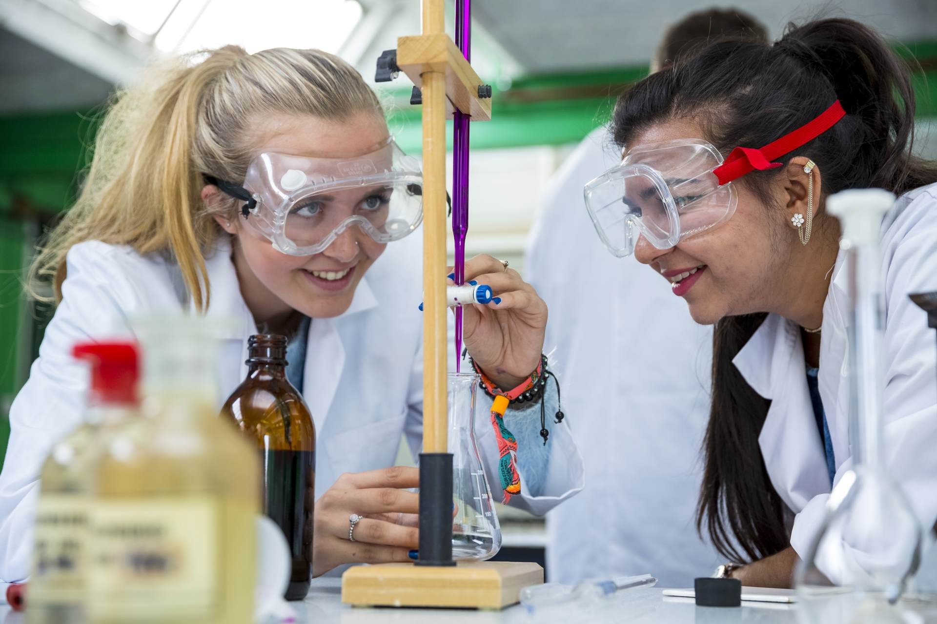
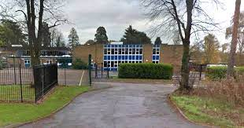
Thank you for coming
You will receive an evaluation via a Microsoft Form link. Please do take a minute to complete this and tell us how useful the meeting was and how we can develop it further.
If you have any further questions, please contact Mrs. Thompson.

